Slide 1


The GameStop Story
A stock without serious growth potential was shorted by institutional investors (Hedge Funds)
Retail investors (fueled by Redditers) made a hysteria around the stock and bec. of the heavy buying, they pushed up the price, which caused short squeeze
Short squeeze triggered stop losses, which moved the price even higher
Resulted a rapid and unusual stock price increase. From 70-80s to 380 about two weeks

Slide 2
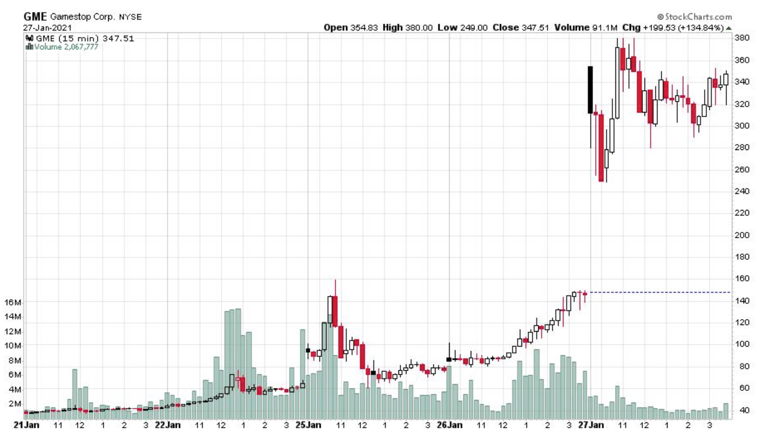

Slide 3
Lesson Learned from GameStop Story
Redditers played key role to be able to spread the story and “advise”. Rapid trading reactions (heavy purchases) was executed by online trading platforms (Robinhood, TD Ameritrade etc.)
There can be serious mispricing (anomalies), which results heavy over or under valuations temporarily. Where the price has no real connection to the fundamentals
After a while fair prices get back near to the fair valued level.
Work with predetermined stop loss levels to avoid serious loss. Be disciplined!
Never underestimate the power/volatility and risk of the market

